Slide 1
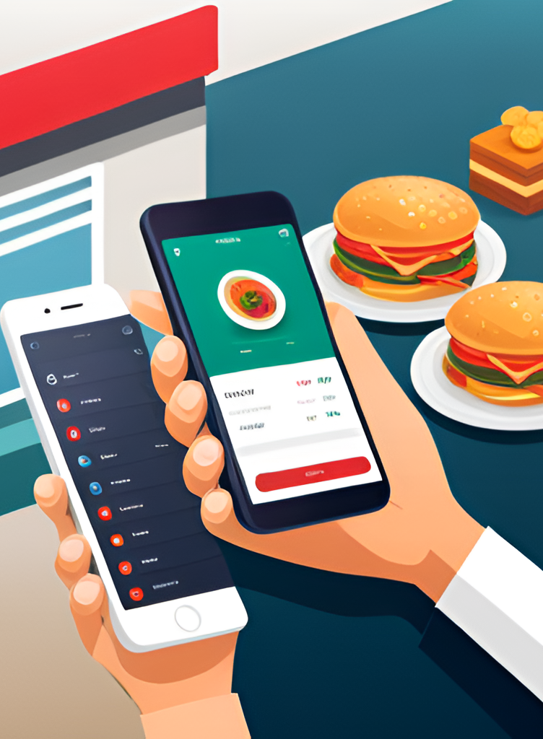
Food Delivery Time Prediction
Team Members:
Anuja Surana 002644394
T Navya Sushma 002708292
Pratik Poojari 002645173
Vaidehi Tawde 002643847

Slide 2

Introduction:
In today's fast-paced world, the food delivery industry plays a crucial role in meeting the demands of convenience-hungry customers. The success of this industry hinges on the precision and timeliness of its deliveries. Today, we delve into a critical aspect that significantly impacts customer satisfaction and overall experience - the ability to predict delivery times accurately.
Definition of the problem:
In the realm of food delivery, accuracy isn't just a luxury; it's a necessity. Customers eagerly anticipate their orders, and accurate delivery time prediction is pivotal in managing expectations. Our project centers on constructing a predictive model capable of estimating the time taken for a delivery. By analyzing various order and delivery process features, we aim to provide customers with reliable time estimates and businesses with enhanced resource allocation strategies.

Slide 3

Rationale of Target Variable Selection:
The heartbeat of our project is the target variable "Time_taken (minutes)." This variable encapsulates the very essence of customer satisfaction. Accurate prediction of delivery times empowers businesses to set realistic expectations, optimize delivery routes, and allocate resources effectively. By mastering this aspect, we can revolutionize the way customers perceive the food delivery experience.
Step 1
EDA with Visualization to understand the data
Step 2
Data Preprocessing
Step 3
Build models:
Random Forest
Linear Regress.
XGBoost
Step 4
Train the Models
&
Make Predictions
Step 5
Evaluate Model Performance
Step 6
Visualize Results
Methodology:

Slide 4
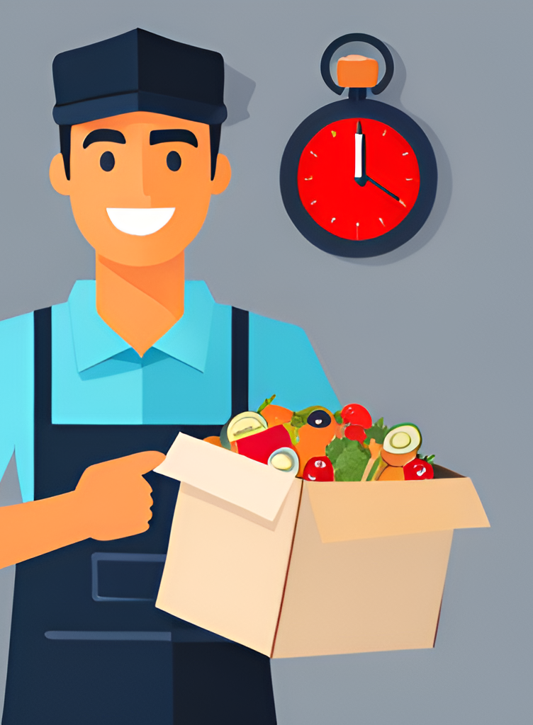
Machine Learning Approach:
As we ventured into solving this challenge, the world of supervised regression opened its doors to us. Supervised regression is the perfect match for predicting continuous numeric values based on input features. Our exploration led us to employ a diverse array of regression algorithms, each with its unique strengths:
Linear Regression
Lasso and Ridge Regression
Decision Tree Regression
Random Forest Regression
Support Vector Regression
XGBoost Regression
AdaBoost Regression

Slide 5
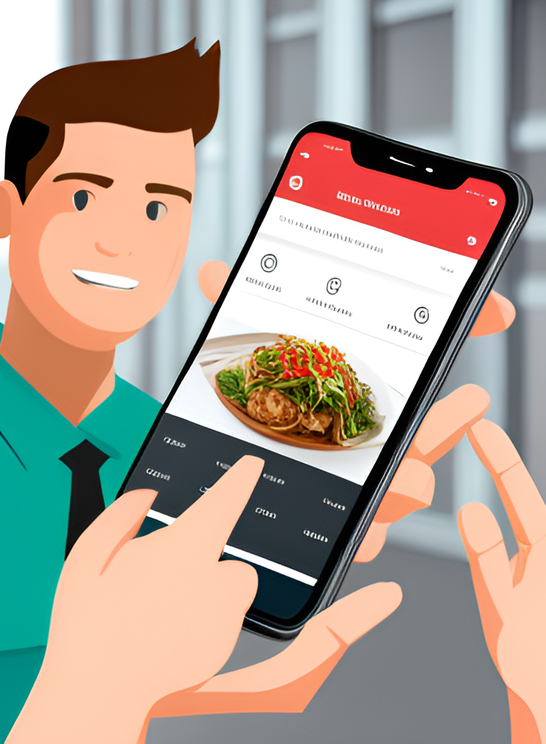
Conclusion:
Our efforts culminated in the creation of a predictive model poised to redefine the food delivery landscape. By providing accurate delivery time estimates, we can elevate the customer experience to unprecedented heights. Through accurate predictions, we bridge the gap between anticipation and reality, fostering satisfaction and loyalty.

Slide 6
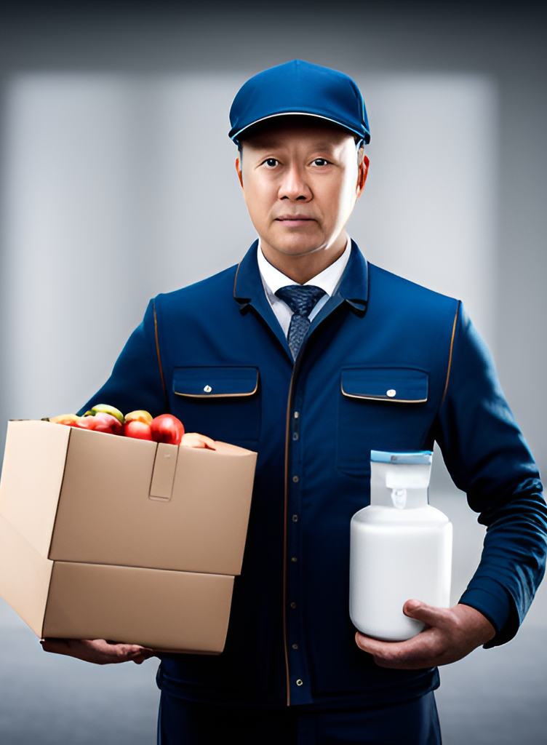
Scope for Future Work
While our model shines bright, there's still a world of possibilities waiting to be explored:
Real-time Traffic Integration: By incorporating real-time traffic data, we can adapt to dynamic road conditions and provide even more precise predictions.
Deep Learning Dive: Delving into deep learning techniques can unveil complex patterns hidden within the data, pushing our predictions to new horizons.
Continuous Refinement: Establishing feedback loops involving delivery personnel and customers can ensure our model stays attuned to evolving preferences and conditions.

